Slide 1
2020 GRANT
WRITING WORKSHOP

Slide 2
Grants to Teachers and Schools Program
Grants to teachers
Up to $1,500.00
Individual teachers, or a team of teachers
An individual applicant may only apply once for EACH of the following types of grants: Individual Teacher, Team and School Site Grant
School Site Grants
Up to $2,000.00 per elementary campus
Up to $5,000.00 per secondary campus
There is no limit to the number of site grants that may be submitted however a maximum of 3 per campus will be awarded
3. Founders Grants
Up to $20,000 Must Involve the Entire School Site or an FBISD Department.
Notes:
Welcome to grant writing training about How to Write a Successful Grant Application to the Fort Bend Education Foundation
First, a few fast facts!
The Foundation was founded in 1992, our mission is to provide opportunities to enrich and enhance the quality of education for all Fort Bend ISD Students through our grants to teachers and schools programs, staff development grants, and new teacher gifts for teachers beginning their teaching career.
Since Inception the Foundation has awarded over 33 million dollars to Fort Bend ISD teachers and schools, and we are very proud to say We touch every school in the District! Ready to get started? Could you use $1500 for your classroom?

Slide 3
Grant Administration
Grant Applications are due the fourth Thursday in January - by 11:59 PM and must include your principals approval.
All applications are coded to ensure anonymity.
In the application you must choose the content area appropriate to your request, Each grant is directed to the area curriculum coordinator for review. They do not score the application but ensure that it meets FBISD instructional standards, is age and grade level appropriate and there is no outside funding available.
The FBEF Allocations committee which is made of members from the Education Foundation Board of Directors read and score the grants.
Funding notification letters are sent out in late April.
Budget codes for ordering are given in May at our Annual Grant Awards Ceremony.
Grant items should be ordered prior to the end of the School year and on campus for the fall semester.
Notes:
. Grant Applications are due the fourth Thursday in January - by 11:59 PM and must include your principals approval.
All applications are coded to ensure anonymity, Readers do not know which school or what teacher submitted the grant, thus assuring a non-biased process.
In the application you must choose the content area appropriate to your request, Each grant is directed to the area curriculum coordinator for review. They do not score the application but ensure that it meets FBISD instructional standards, is age and grade level appropriate and there is no outside funding available.
After the coordinators review
The grants are read and scored by the Foundation’s Allocations committee which is made of members from the Education Foundation Board of Directors. These members are generally not educators, they are business, medical professionals, and community volunteers who want to make a positive impact on education. They are your audience, please keep in mind they may not know the educational buzz words or acronyms so explain what you are writing about. Each grant is read and scored by two different board members, if there is a disparity of twenty points a third person reads the grant. When this process is complete
Funding notification letters will be sent out in late April.
Budget codes for ordering will be given in May at our Annual Grant Awards Ceremony.
Grant items should be ordered prior to the end of the School year in the hopes that the items will be on your campus when you return for the fall semester.

Slide 4
Application Guidelines
The purpose of this program is not to increase performance on a standardized test but rather enhance the educational experience in the classroom
Grants that demonstrate creative and effective implementation and inspire students to learn will be graded higher
Grants that directly benefit large numbers of students will be given preference
Grants which utilize durable, reusable items will be given preference
Grants that share materials and/or techniques between grades, groups, schools, etc. will be given preference
Review all Guidelines and Policies prior to writing your Grant.
Notes:
Application Guidelines
Please Review all Guidelines and Policies prior to writing your Grant.
The purpose of this program is not to increase performance on a standardized test but rather enhance the educational experience in the classroom, by making learning fun and hands on!
Grants that demonstrate creative and effective implementation and inspire students to learn will be graded higher
Grants that directly benefit large numbers of students will be given preference, However grants which serve populations with special needs are taken into consideration. Please do not be afraid to write in your grant the unique needs of your students, or your school. Maybe your school is Title One, Economically Disadvantaged or overcrowded. You may write that into your application as long as you do not identify your school.
Grants which utilize durable, reusable items will be given preference
Grants that share materials and/or techniques between grades, groups, schools, etc. will be given preference

Slide 5
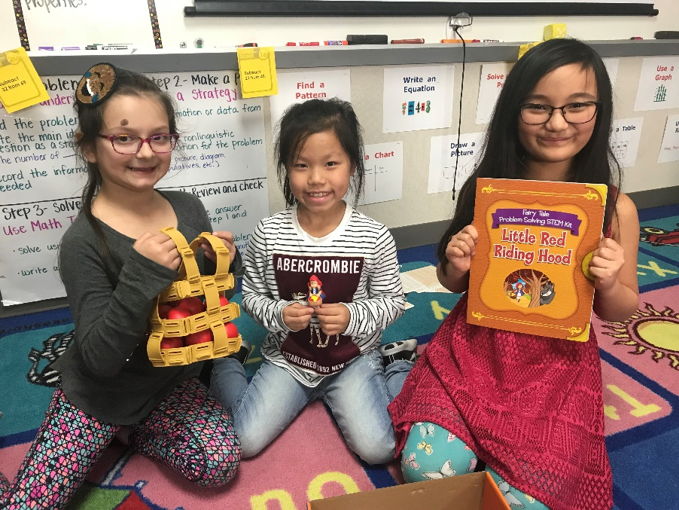
Documentation Preparation Guidelines
Correct grammar and spelling are a MUST
Pictures or catalog pages must be uploaded into the application
Export and/or print your application.
Reader mode must be turned on to print!
Proofread your grant!
Always hit save prior to leaving the application.
Once you hit submit you cannot make changes
Notes:
Correct grammar and spelling are a MUST
Pictures or catalog pages must be uploaded into the application
Export and/or print your application.
Reader mode must be turned on!
To print you must click on Print to ensure all pages print.
Proofread your grant!
Always hit save prior to leaving the application. ** please note once you start an application weather you save or not it will remain in the system so search for it, prior to creating a duplicate application.
Once you hit submit you cannot make changes

Slide 6
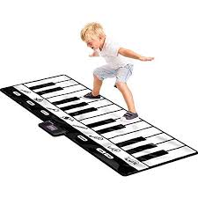

Slide 7
Policies!
No funds will be awarded for field trips, i-pads salaries, teacher trips , training, subscriptions, food, or speaker fees.
No funds will be awarded for multiple applications from an individual school to fund an entire program
The Foundation will not fund grant request which exceed the stated dollar limit.
Notes:
Policies
Grants requesting i-pad must be submitted under a school site application
No funds will be awarded for field trips, salaries, teacher trips , training, food, or speaker fees.
No funds will be awarded for multiple applications from an individual school to fund an entire program. For example: Each team in an elementary school writing for leveled reading books, in an effort to create a campus library of leveled reading books.
The Foundation will not fund grant request which exceed the stated dollar limit. If your grant exceeds the limit you need to explain where the additional funding will come from. PTA/PTO, business partner, campus budget, fundraiser, etc.

Slide 8
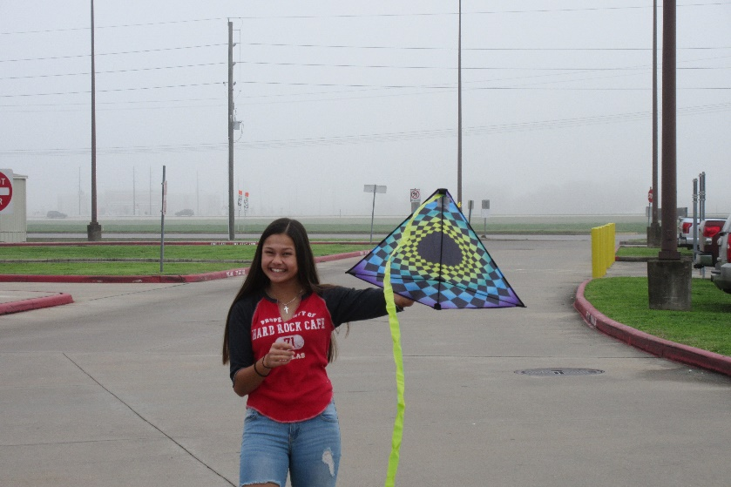
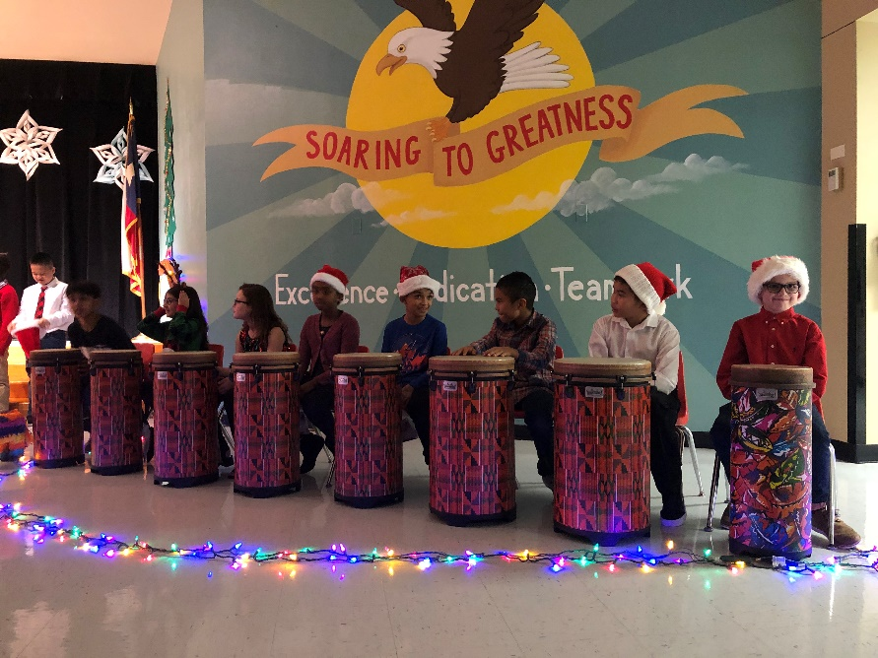
Write a Great Grant!
Travis High School (Math and Science) - Come Fly Away with Math in Our World!
Using kites, a long tape measure, and a clinometer’s angle-finding ability, students make trigonometry come alive. These items provided with this grant enrich the Geometry unit on Trigonometry. Students make connections to real world problem situations that can be solved with math they are learning in class.
Colony Bend Elementary School (Fine Arts) – Drum Up Some Fun!
Tubano drums provide students with hands on learning of beat and rhythm while utilizing their creativity. Students benefit greatly in practicing musical skills and working as an ensemble. They take pride in ownership of performing and creating their own music. Tubano drums are a vehicle of musical exploration and bring great joy to the students.
Notes:
Write a Great Grant,
This slide is an example of a grant in Action funded by the Foundation –that can be found in classrooms throughout the district today. Occasionally we will ask for pictures of your grant in action for publicity purposes.

Slide 9
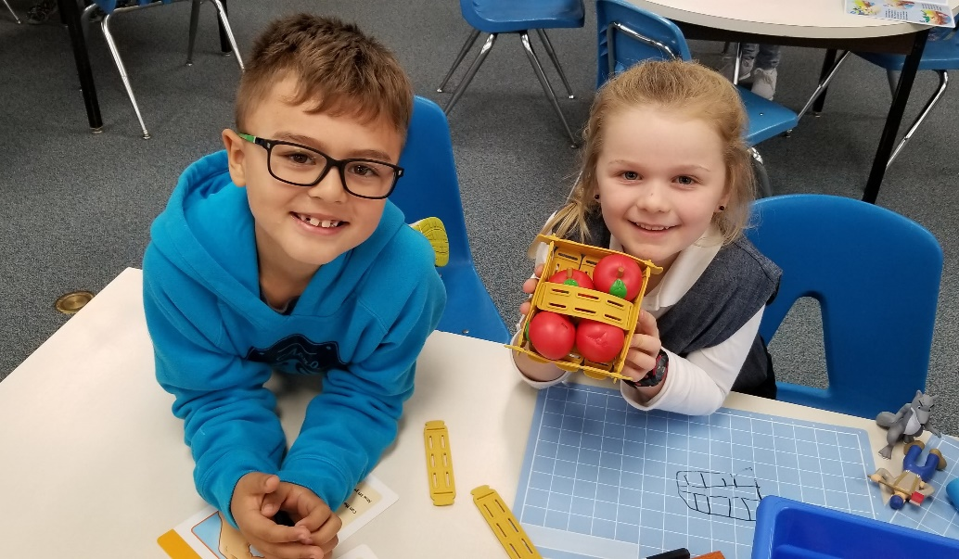
Developing your Grant
Ideas from Professional journals, catalogs
Durable and Reusable
Maximum student benefits
Focus on interactivity
Unique needs of your students
Foster student- teacher involvement
Notes:
Let’s talk about the Basics for developing your grant
Where can you find Ideas for items to write for?
From Professional journals, vendor catalogs, and grant summaries posted on the foundation website.
Grant summaries include items asked for and dollar amounts requested. Make sure the items you request are durable and reusable.
When developing your grant you should express to the reader the
Maximum student benefits
Focus on interactivity – between the student and the items requested.
Tell the reader the Unique needs of your students – gift and talented, special education, ESL, etc.
Foster student- teacher involvement
* Do not mention the name of your school or your name in the grant as this will disqualify you.

Slide 10
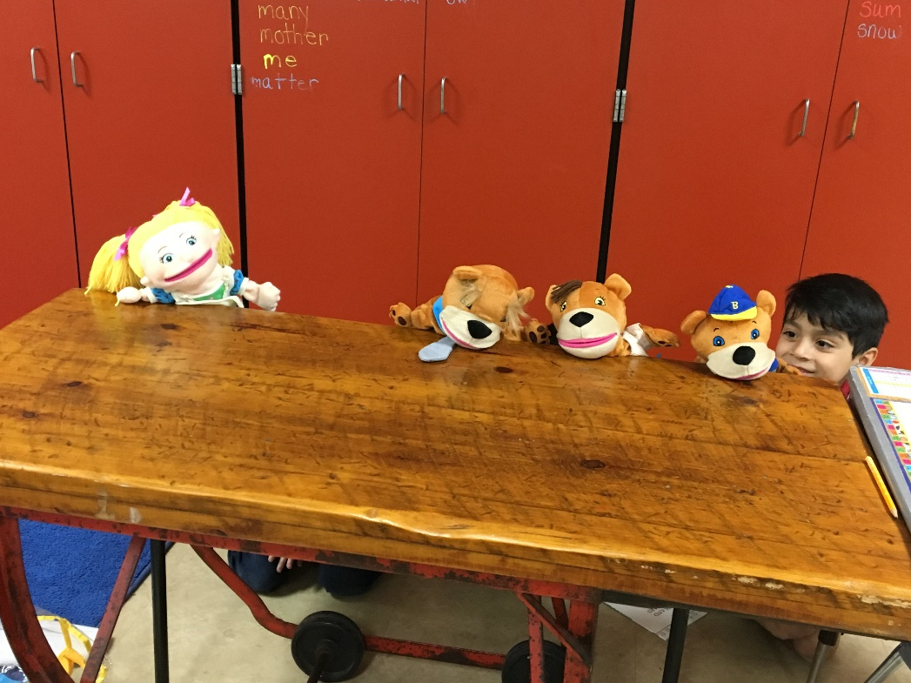
Develop a “Big Picture”
Create a major curricular theme which:
Benefits learning styles and abilities
Challenges developmental levels
Involves many students
Consistent with district and state standards
Notes:
Be sure to Create a major curricular theme which:
Benefits learning styles and abilities
Challenges developmental levels
Involves many students and is
Consistent with district and state standards

Slide 11
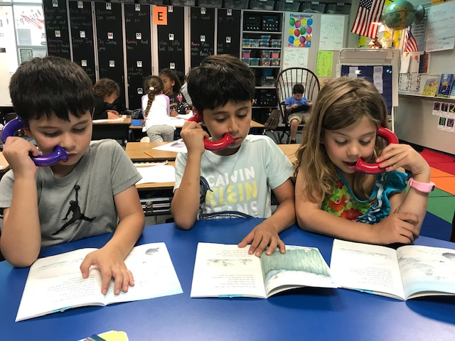
The Grant Introduction
Explain carefully the grade level or course you teach.
Why is there a need?
Describe what you want
Explain the benefits for your students

Slide 12
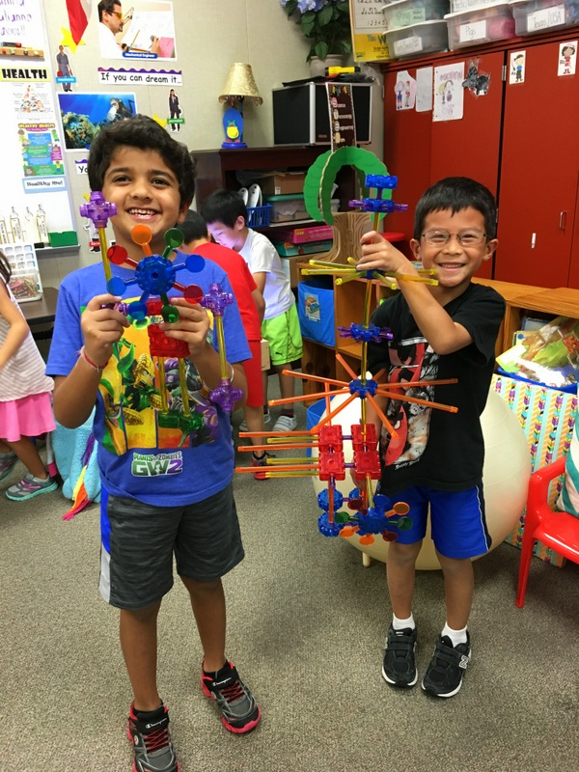
More on the Introduction..
Write succinctly
Use verbs (Google Blooms Taxonomy)
Edit carefully
Build the need
Explain unique aspects of your idea
Sell benefits
Be enthusiastic!
Notes:
Write succinctly
Use verbs (Google Blooms Taxonomy)
Edit carefully
Build the need
Explain the unique aspects of your idea
Sell the benefits and above all
Be enthusiastic! Tell the reader how your grant is will make learning FUN and Hands ON!

Slide 13
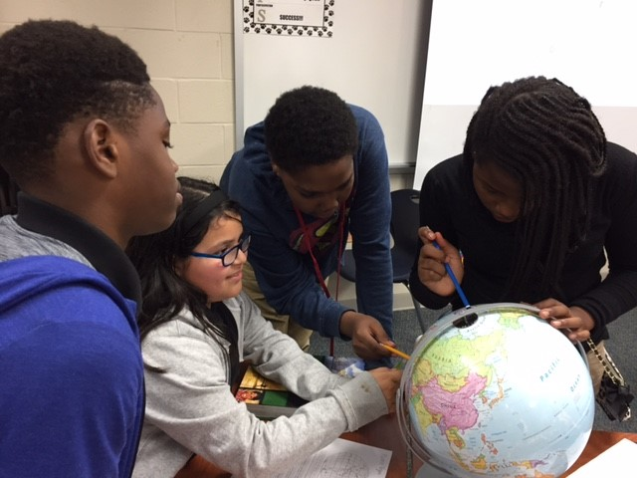
Budgeting your Grant
Plan carefully
Time lines to order
If required who is going to install it?
Durable/reusable items
How are you going to store it?
Supplies needed batteries, accessories, licenses, cases, carts, etc.
Shipping fees
Show district discounts on spreadsheet
No Sales TAX!!!!!!
Notes:
Plan carefully
Look at the Time lines to order to ensure your grant will be delivered in a timely basis.
If required who is going to install it?
Durable/reusable items
How are you going to store it?
Supplies needed batteries, accessories, licenses, cases, carts, etc.
Shipping fees
Show district discounts on spreadsheet
No Sales TAX!!!!!!

Slide 14
Grant Specific Questions
1. In your own words, provide a description of the grant proposal and explain carefully why there is a need, describe what you want and the benefits for your students. Do not use abbreviations for educational acronyms. Do not cut and paste information from marketing materials. (Do not mention school name in title or body of proposal.):*
2A. Share one to three goals. For each goal, write how you will know if you have achieved it by explaining your definition of success. * *
2B. The bell rings and the students are coming into class, in your own words, specifically describe how this grant will be used in a lesson in your classroom today to enrich, extend, engage or motivate your students learning and creativity. Using your words paint a picture we can see! (do not copy and paste from a computer generated lesson plan)*
2C. Give a time schedule of Implementation.*
3A. How many students will be directly affected by this project?*
3B. Will this grant impact more than one classroom, grade, or school? (explain)*
3C. Approximately how many hours of use in a school year will the items requested be utilized? (example: Everyday 1 one hour a day for 180 days = 180 instructional hours)*
Notes:
All questions have a character limit in the answer box, we are not trying to make this a hard process, we value your time.

Slide 15
3D. How long will this grant be used?
Summary of Items to Purchase:*
4. Budget Plan:
Include a budget line for Shipping for each vendor. Refer to application instruction sheet for more detail.
It is required that you obtain a written quote from each vendor (this is NOT a web quote or a copy of the current pricing). Contact our vendor's representative listed on the Master Approved Vendor List and ask for a quote guaranteeing the prices until August 31st. Keep this quote to use when ordering. DO NOT include the quote with your request.
Amazon and Walmart are NOT district approved vendors.
**Note- All questions have a character limit!

Slide 16
Online Grant Application Instructions
This website works best with Google Chrome. If other browsers are used, it will affect speed and format.
Go to http://secure.fortbendisd.com/fbefgrants/
• At any point during the application process, you may click “save for later” and return to your grant application. * Please do not start a duplicate application! Use the search screen to find the application(s) you are working on by your name
• Your application is not submitted until you click “submit”.
Click the FBISD Employee box.
* Login with Username and Password.
Read the Grant Application Process.
Click Application on the top menu bar.
• Choose New Application for a new grant.
• Choose Application Search for a grant you have already started.
Click okay on message from webpage after reading (first time users only)

Slide 17
Complete Application
• Campus
• Grant Type
• Choose Individual or Team * List Team Members with first and last names only – no titles, For groups larger than seven create a group name.
• Application Guidelines will appear next
* We highly recommend reading the Guidelines before proceeding.
• Content Area – when writing across curriculums, choose the content area that most of the resources you are asking for in your budget come from.
• Purpose
• Position
• Are you an Itinerant Employee?
* Do you work at multiple Campuses?
• Grant Title (Do not mention the school name in the title.)
• Grade Level(s)
• Conditions—must agree by clicking the boxes
Continue with the grant specific questions.

Slide 18
Budget Plan
It is required that you obtain a written quote from each vendor (this is NOT a web quote or a copy of the current pricing). Contact our vendor’s representative listed on the Master
Approved Vendor List and ask for a quote guaranteeing the prices until August 31^{st.}
Keep this quote to use when ordering. DO NOT include the quote with your request.
When investigating vendors, discounts and contacts for the vendor to get a quote please Click on the Master Vendor List provided on the grant application page of our website.
In the Master Vendor List, the column header category tells you what items the vendor’s contract were awarded for. If you click on the drop down arrow, you can filter this by “books” and all the vendors that we can purchase books from will be sorted to the top.
You can use this filter for almost anything you want to purchase.

Slide 19
In the application on Question 4.
Click “Add Budget Line”
Choose the PeopleSoft Vendor in the pop up menu. Wal-Mart and Amazon are not an approved vendor and cannot be used to purchase items in your budget!
Only District approved Vendors and District approved products are allowed. Vendors and FBISD Buyer contact information is available when you click “here” in the blue box. ***Your campus secretary or department chair can also help***
• PeopleSoft Vendor Number will populate automatically.
• Enter Vendor Item Number
• Enter Description
• Enter List Price and Discounted Price (this may be the same or different)
• Enter Quantity.
• Click Save and Return to Application or click Save and Enter Another if you have more than one item.
* The system may be slow when adding budget items, do not continue clicking save, otherwise multiple lines of the same item will appear.

Slide 20
• A shipping line must be added for each vendor, even if they do not charge for shipping.
Select the PeopleSoft Vendor Name and the PeopleSoft Vendor Number will populate automatically.
* Vendor Item number enter Shipping
* Description: enter Shipping
* List Price and Discount Price: enter the shipping amount, enter “0” if no shipping charge
Quantity: enter “1”
* Download your final budget and save and/or print it, so you will have it available if you are awarded the grant. It will be needed to order your items.
• It is required that you obtain a written quote from each vendor (this is NOT a web quote or a copy of the current pricing). Contact our vendor’s representative listed on the Master Approved Vendor List and ask for a quote guaranteeing the prices until August 31st. Keep this quote to use when ordering. DO NOT include the quote with your request

Slide 21
Upload Supporting Documents
You must upload at least one picture(s) and/or Catalog page(s) of items requested.
PRIOR TO CLICKING SUBMIT:
Export and/or print your grant application. This will allow you to keep a copy of the written part of your grant and edit your grant so you can copy and paste in the change to the application. There is no access to the grants once the application process is closed.
Download your final budget, so you will have it available if you are awarded the grant, It will be needed to order your items.
In order to export or print, ensure Reading Mode is turned on— see top of grant application page
To print, you must click Print rather than Control P so that all pages print.
Proofread your grant! Once you click SUBMIT, you CANNOT make changes.
Click Submit
If you do NOT get a message that it was submitted successfully, please scroll to the top for an explanation of missing criteria.
After you submit your grant your principal will receive an e-mail requesting approval.
Please follow up with your principal to ensure that he/she approves the grant.

Slide 22
(* Subjective *) PROGRAM DESIGN Score _____ 3* Educational Enhancement Identified “Does it improve or add value to the campus?” 2* Inspires and Motivates students to learn “Does it include activities that make learning fun, or make students want to learn (especially hard to reach students?)” 2* Innovative and /or Novel, Design in Implementation “Will the materials/program be utilized in a fashion that is creative? Key on innovation isn’t tied to the product/program…rather on how it is used”. 1* Large # of students benefitted? “While important do not ignore or penalize grants focused on special populations.” 1*Materials and techniques shared between schools, groups & grades? “Does or can this grant include more than one classroom, grade or school?” 1* Long Term impact on Students/Campus/ Staff “Can you determine that this grant will make a difference on the campus outside the initial use?” Are the materials sturdy enough to be re-used multiple times? | ___X10 100 pts. possible
DESIGN/EVAULATION Score _____ 5*Did the teacher Convey how success will be measured exclusive of standardized test scores? “How is it going to e measured, Preference will be given for creative measurements” 6*Goals clearly stated “Does the writer communicate specifically what they expect to accomplish with this grant?” 6* Plan to achieve goals clearly communicated “Can you see that the author has identified and understands what they expect to see achieve?” | ___X5 70 pts possible
Notes:
The School Site Application Evaluation is the exact score sheet our readers use to evaluate your application.
There are four parts to this score sheet. Program/Design, Design/Evaluation, Budget Plan and Compositional Quality.
Lets look at Program Design If the writer can convey to the reader in Question number one that the items requested will improve or add value to class room or campus the grant is awarded three points. This section has 5 questions – there value is posted in front of the question, the 5 questions are worth 10 points and we multiply that section by 10 for a total of 100 points.

Slide 23
COMPOSITIONAL QUALITY Score _____ 1* All requested information provided “Self explanatory?” 2* Correct grammar & spelling “Do grammar and spelling errors detract from the quality of the grant?” | ___X5 15 points possible
SCALE: 186-200 Excellent 172-185 Good 160-171 Satisfactory Based on weighted scores. | ____ 200 points possible.
Notes:
186-200 is Excellent
172-185 is Good
160-171 is Satisfactory
Grants generally win in the 182 and up range. Last year we funded nearly 60% of all grants requested. Campuses that are funded a large number of grants generally set up a team of teachers who review, critique and score the requests prior to sending them to the Foundation. Thus giving the writer excellent feedback.

Slide 24
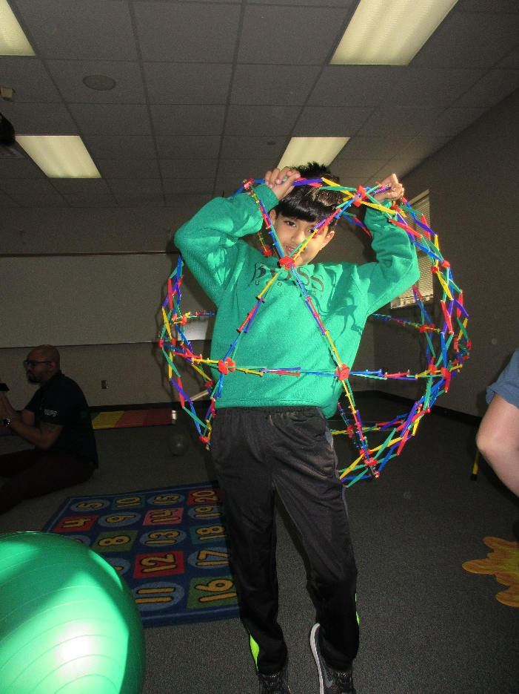
Why you should write a GOOD Grant!
Refreshes your creativity
Bring a memorable and unique project to your students.
Excites your imagination
Provides a sense of pride in yourself.
Notes:
Why you should write a GOOD Grant
Refreshes your creativity
Bring a memorable and unique project to your students.
Excites your imagination
Provides a sense of pride in yourself.

Slide 25
Grant Application, Grant Summaries and the master vendor list may be found on our website at
www.fortbendisd.com/foundation
Have a question e-mail
fbef@fortbendisd.com
Good Luck!

